Slide 1
Human Cloning:
Ethics
By: Logan Gleeson,Scott Fischer, Jonathan Stickle, Sawyer Ikeda, Poh Maga

Slide 2
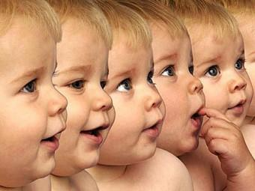
What is Cloning?
Cloning is the use of an organism’s genetic material to create a replica of that organism

Slide 3
Controversy of Cloning
Many religious groups find cloning unethical and unnatural.
“[cloning is a]...grave offense to the dignity of that person as well as the fundamental equality of people”
-Pope Benedict XIV
There are many moral and ethical issues surrounding cloning.
How would Clones be treated?
What rights would apply to clones?
How would cloning be regulated?

Slide 4
Importance of Cloning
Cloning has several benefits and could be used in multiple different ways
Cloning of humans would be used to advance several field of research and science
In the medical field researchers could use cloning to clone organs to test certain treatments/methods without risk of harming people
They could also use cloning to create donor organs that would not have risk of being rejected
However, the methods that are used are considered to be unethical
This is because scientists are basically creating life through unnatural ways

Slide 5
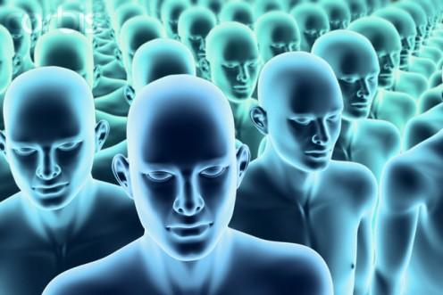
What Cloning affects
-Developments in cloning could be used to further develop other medical technologies
-An organ donated from your own clone will not be rejected by your body

Slide 6
Benefits
May be able to reverse heart attacks
Would be able to more vital organs to save peoples lives

Slide 7
Hindrances/ Disadvantages
Lose sense of individuality and value of life
Clones used as tools and replacement children
Cloning technology could be misused
(army of clones)
Birth Defects (defects seen in later life=prevents organ donation)

Slide 8
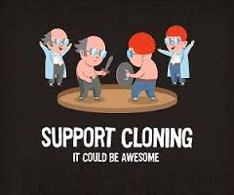
Our own Viewpoints
Benefits scientific research
Organ Replacement
Learn more about human biology

Slide 9
Bibliography
http://www.humancloning.org/essays/dani2.htm
http://healthresearchfunding.org/pros-cons-human-cloning/
http://www.google.com/images

Slide 10
Thank You!

