Slide 1
Current Topics Presentation: The Coffee Genome
Jack Duffin
Archer Leida
Sawyer Ikeda

Slide 2
Coffee Consumption
2013
8.7 million tons produced
Over $11 million in revenue

Slide 3
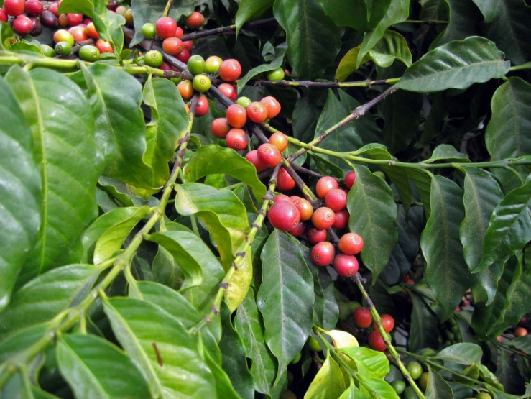
Coffee in Nature
Stunt Competitors’ Growth
Insects
Plants use as repellent (Toxic)
Caffeine addiction in pollinators

Slide 4
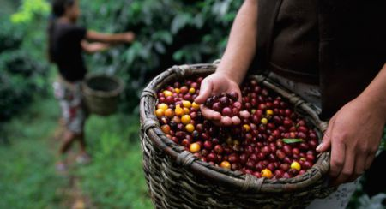
Coffea Canephora
Represents 30% of world-wide production

Slide 5
Coffea Canephora Genome
French Institute of Research for Development
French National Sequencing Center
Contains 23 unique genes

Slide 6
Aroma and Taste
Larger gene families
Production of Alkaloid (Aroma)
Production of Flavonoid Compounds (Bitterness)

Slide 7
Caffeine
Tea
Chocolate
Coffee
Thought to have evolved from common ancestor

Slide 8
Tea
Tea
Starbucks Venti Chai Tea – 40 mg

Slide 9
Chocolate
Chocolate
Hershey’s Chocolate Bar – 9 mg

Slide 10
Coffee
Coffee
Starbuck Venti Brewed Coffee – 415mg

Slide 11
Caffeine
Tea - 40 mg
Chocolate - 9 mg
Coffee – 415 mg

Slide 12
Caffeine in Coffee Genome
Caffeine producing enzymes
Common ancestors would have closely-related enzymes
More closely related to other genes in coffee plant than tea and chocolate enzymes
Suggests that caffeine in coffee developed independently

Slide 13
Importance
With new sequence, we have the genes to:
Develop better resistance to pathogens in wild
Develop better resistance to climate change
And most importantly…

Slide 14
Importance
Improve the taste and aroma of our coffee!

Slide 15
Sources
http://www.buffalo.edu/news/releases/2014/09/005.html
http://www.iflscience.com/plants-and-animals/scientists-have-sequenced-coffee-genome
http://www.aarp.org/health/healthy-living/info-10-2013/coffee-for-health.2.html
http://www.caffeineinformer.com/the-complete-guide-to-starbucks-caffeine

