Slide 1
STEM Curriculum Project
by Bryan, Jacob, Poh, and Sawyer

Slide 2
Overview:
5 Labs
Journal

Slide 3
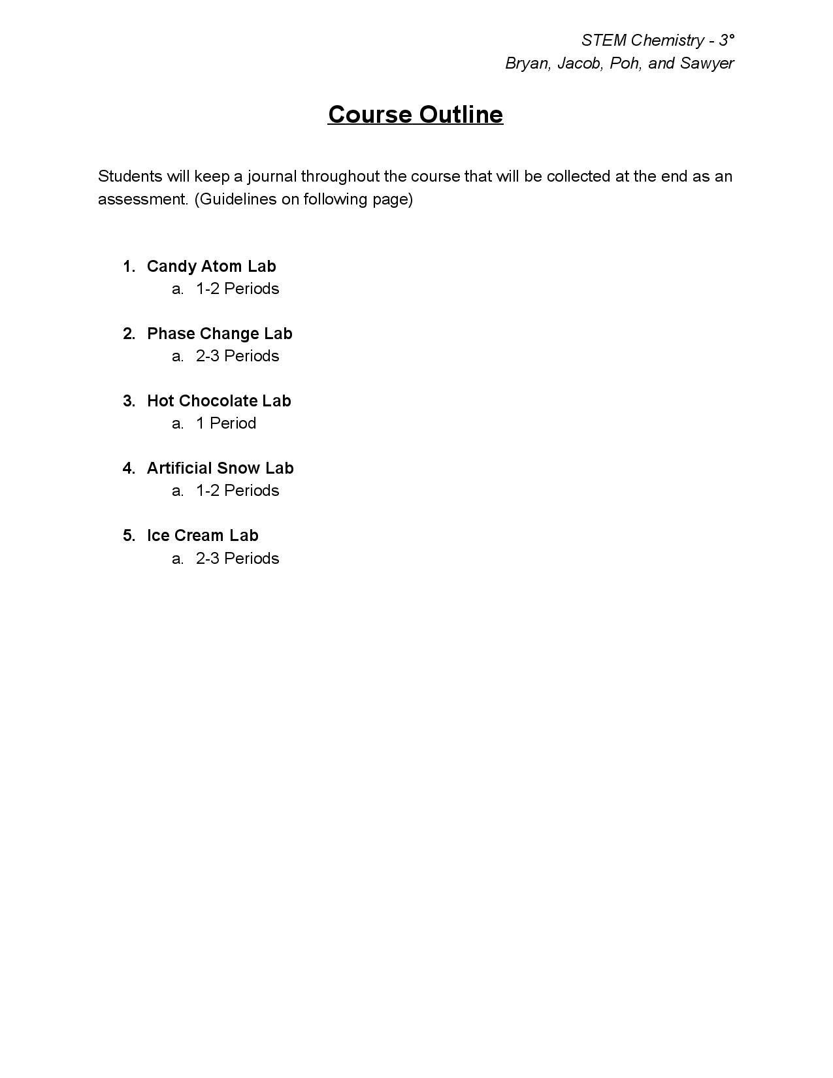
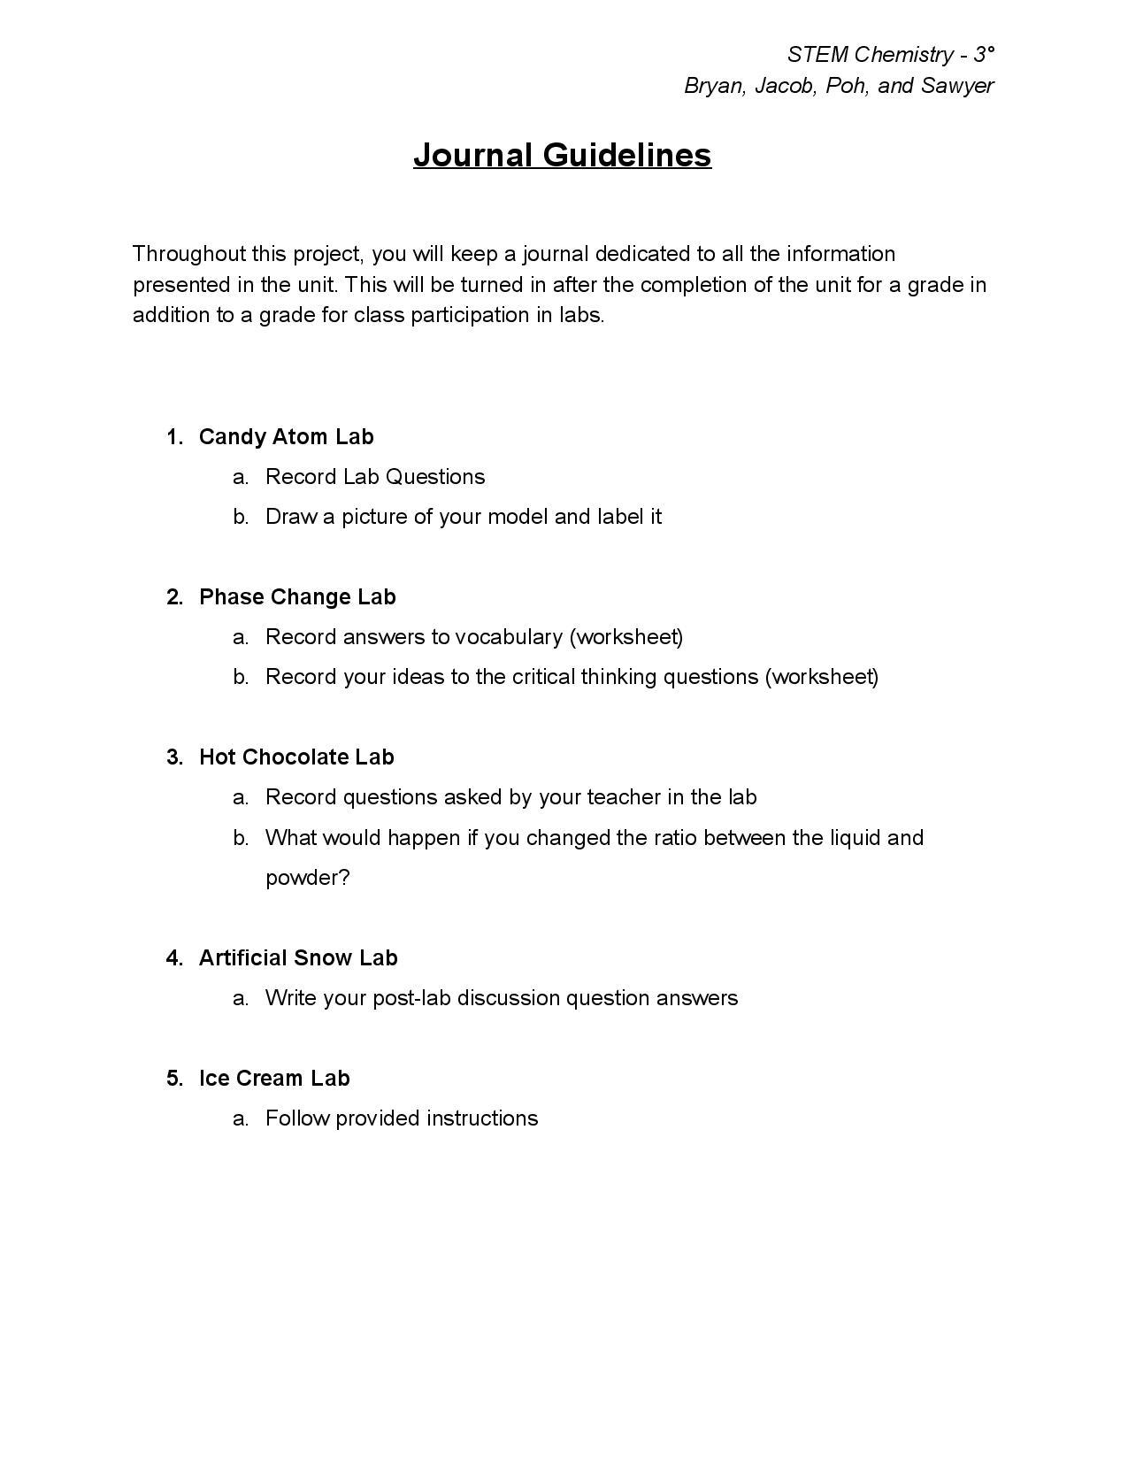

Slide 4
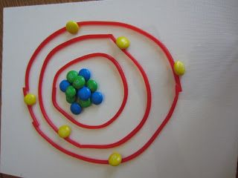
Candy Atom Model Lab
(1-2 Periods)

Slide 5
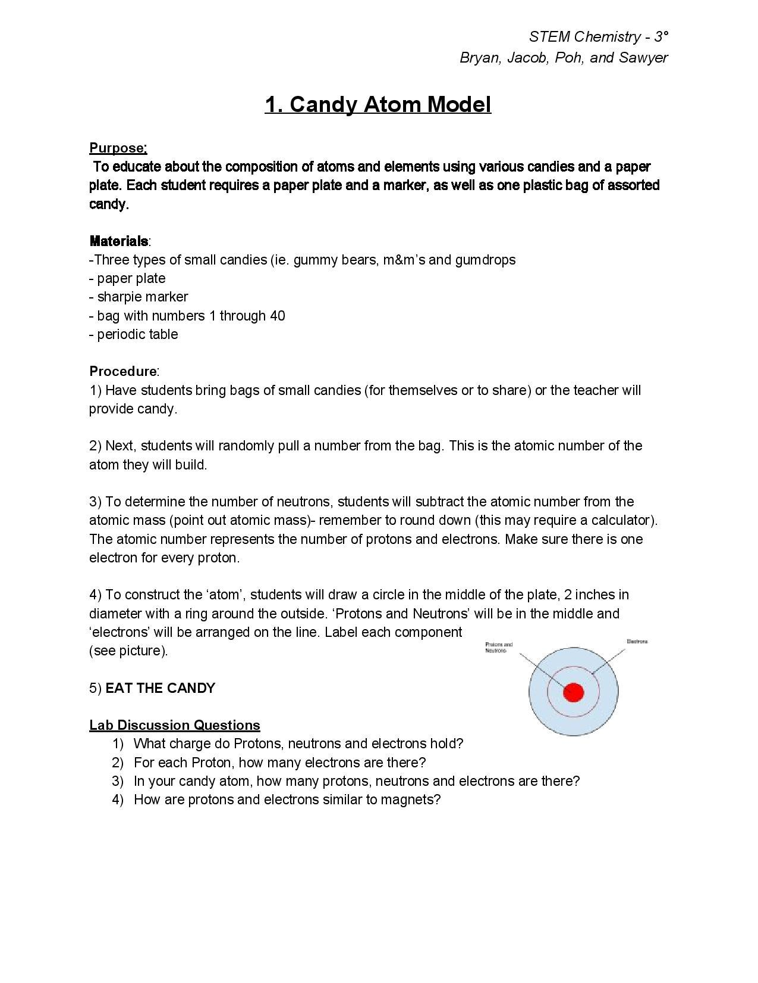
Candy Atom Model Lab (1-2 Periods)
Concepts:
Atoms + Atomic Composition
Elements
Review Activity:
Discussion Questions

Slide 6
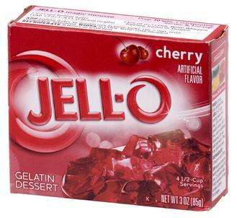
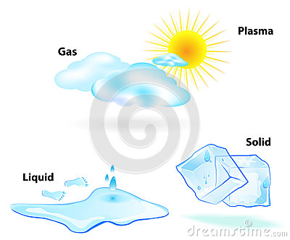
Phase Changes Lab (2-3 Periods)

Slide 7
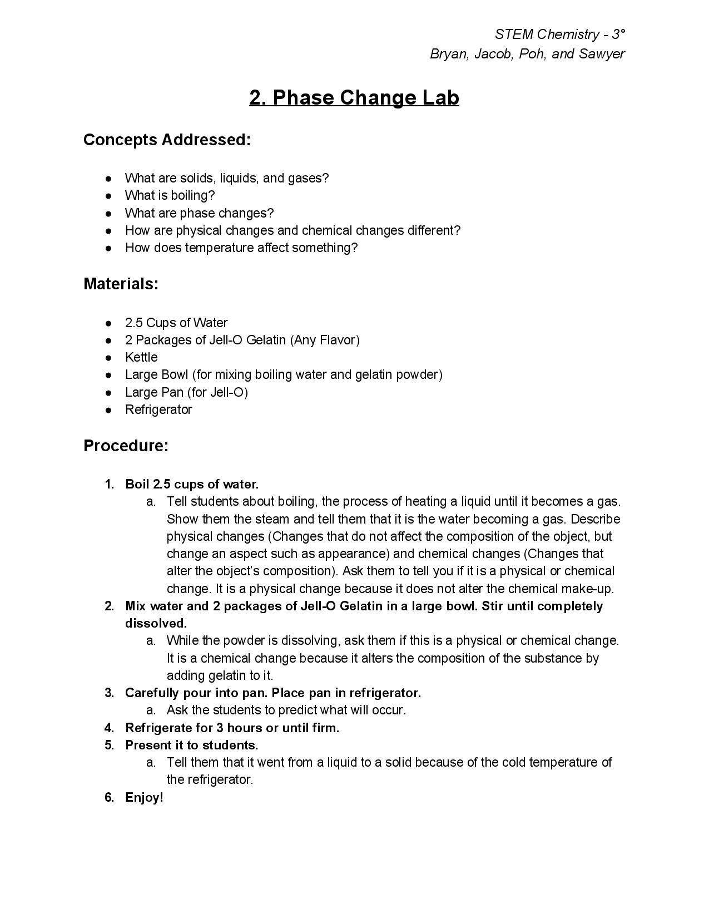
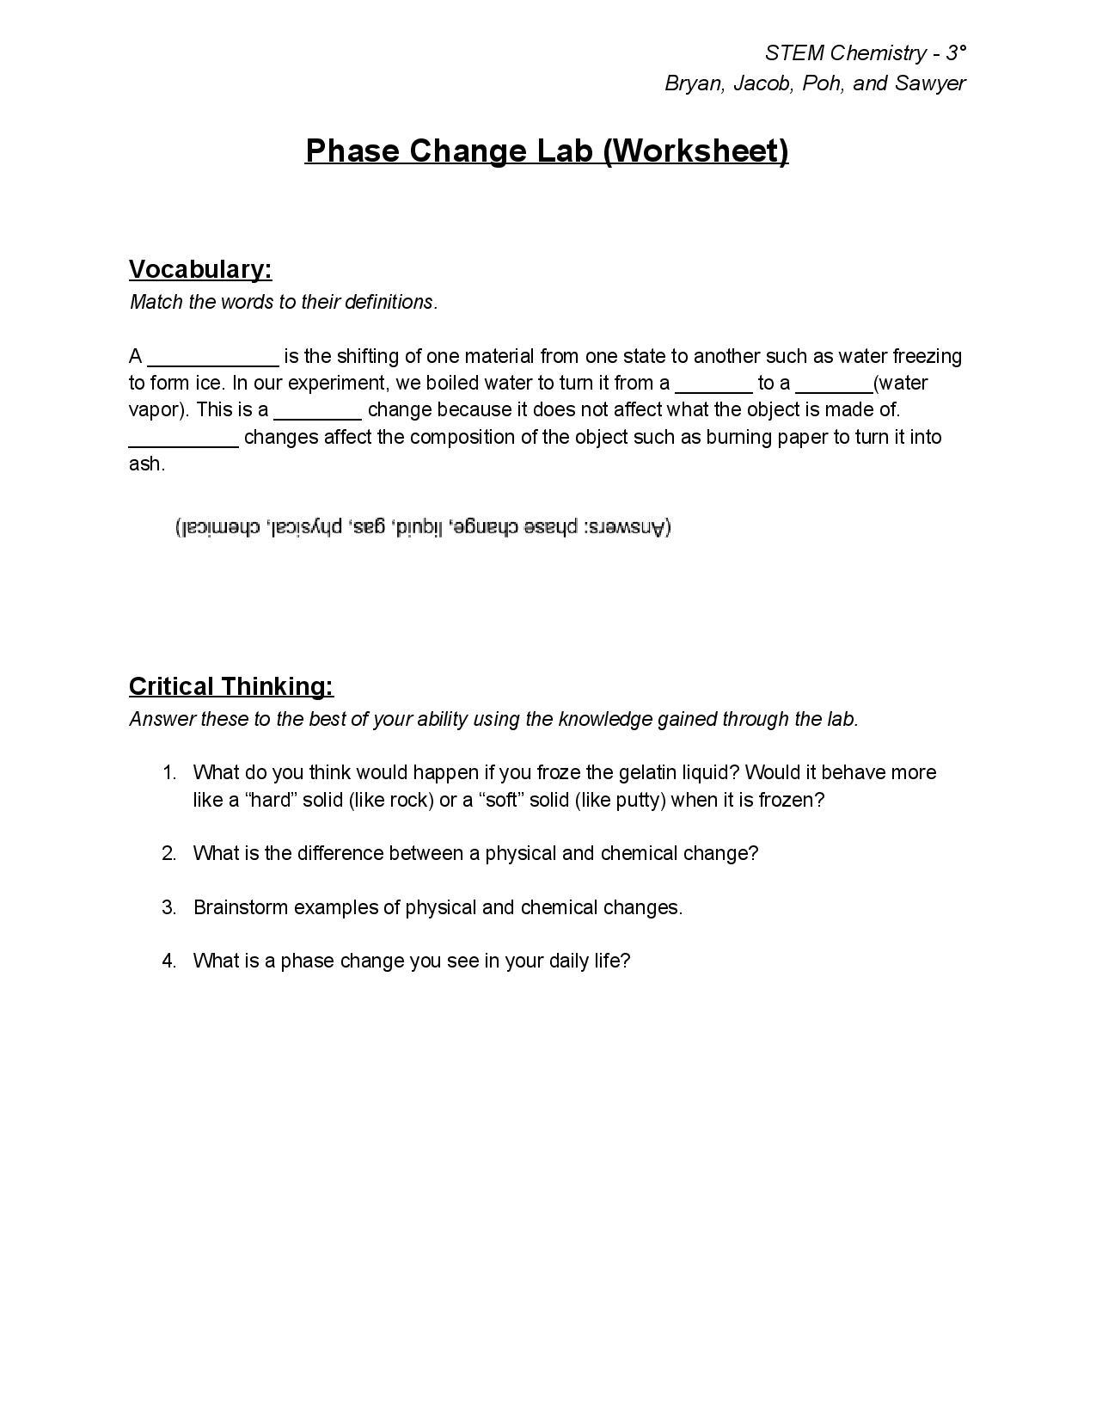
Phase Change Lab
Concepts:
States of Matter
Physical and Chemical Changes
Review Activity:
Worksheet

Slide 8
Hot Chocolate Lab
(1 Period)

Slide 9
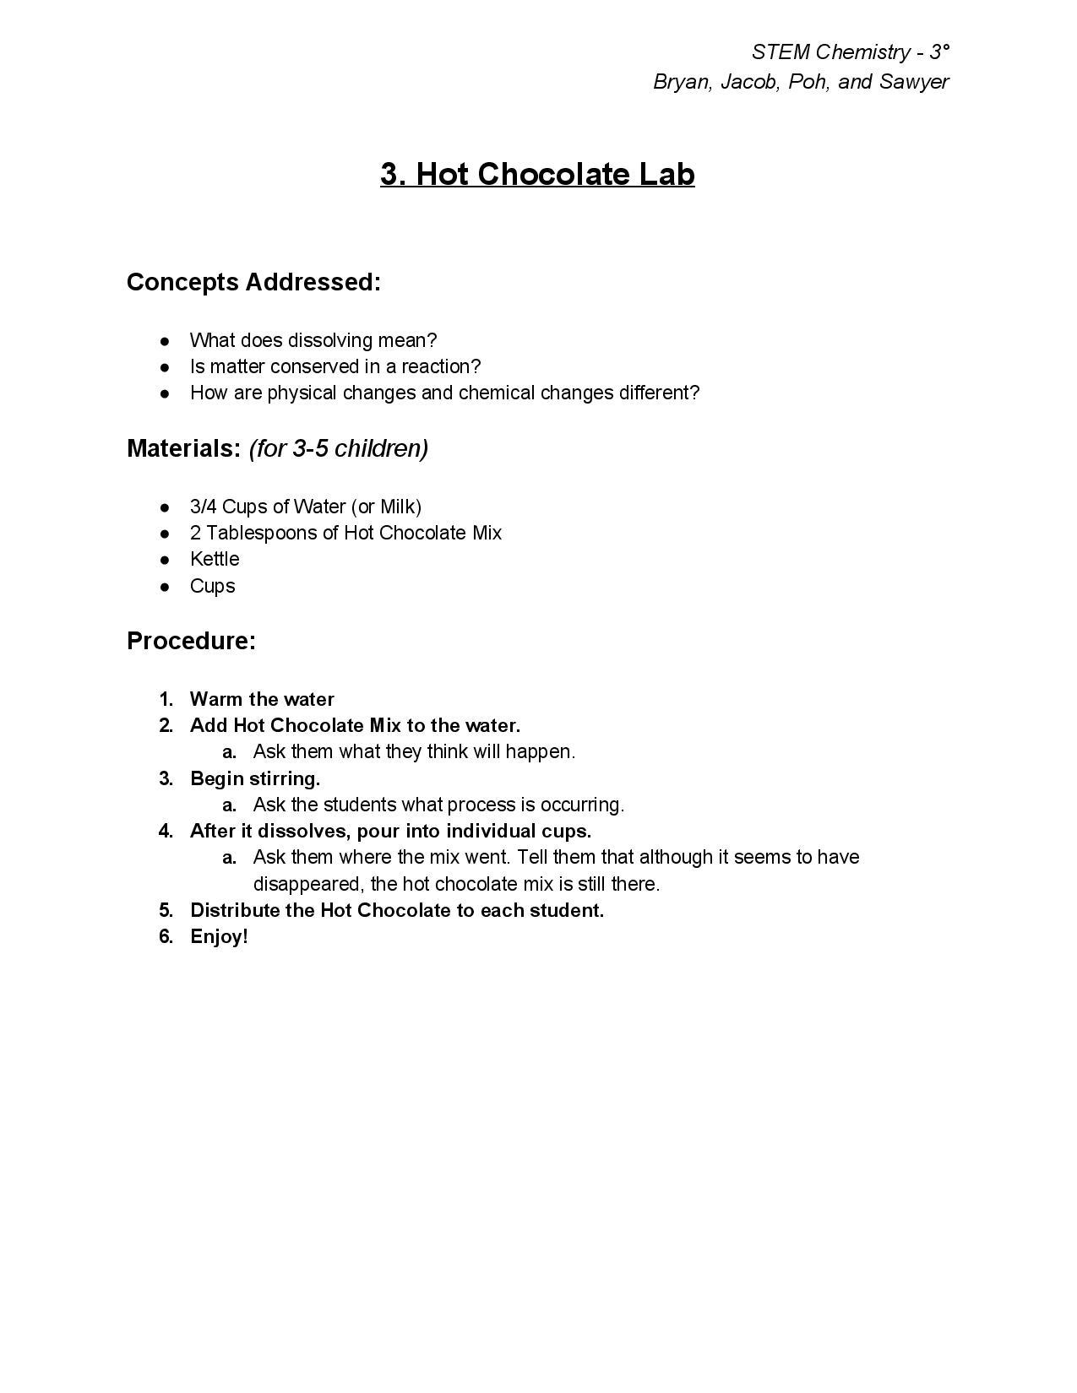
Hot Chocolate Lab
Concepts:
Conservation of Matter
Physical vs Chemical Changes
Dissolving

Slide 10
Making Snow Lab (1-2 Periods)
Journal Overview:
Record observations
Write the post-lab discussion question and answer them
Objective
Work through an example of a physical reaction; substances will physically change but there is no chemical reaction
Discovering a process that is used in the real world while having fun

Slide 11
Ice Cream Lab (2-3 Periods)
Key Concepts:
Freezing temperature of water
Effects of salt on ice
Property change of water
Objective: Making Ice Cream is fun, the students should know the science behind it. They have fun doing this lab and it makes it possible to teach kids these concepts through an avenue they can relate to.

