Slide 1
Murder Mystery
Investigators: Peter, Jason, Sawyer, Ronan, and Andrew

Slide 2
The Crime Scene
Captain Cornball invites Norma Nanny, Theresa Thyme, Fred Fleckstone, Sam Stubs, and Glen Glendora to a picnic at San Marin
The lights go off and Captain Cornball is found slumped over with a knife in his back
The police arrive and pronounce Captain Cornball dead at the scene
Norma Nanny cut her hand on a piece of broken glass during the confusion
The police analyze the blood on the knife. There are two types of blood, one of which belongs to Captain Cornball

Slide 3
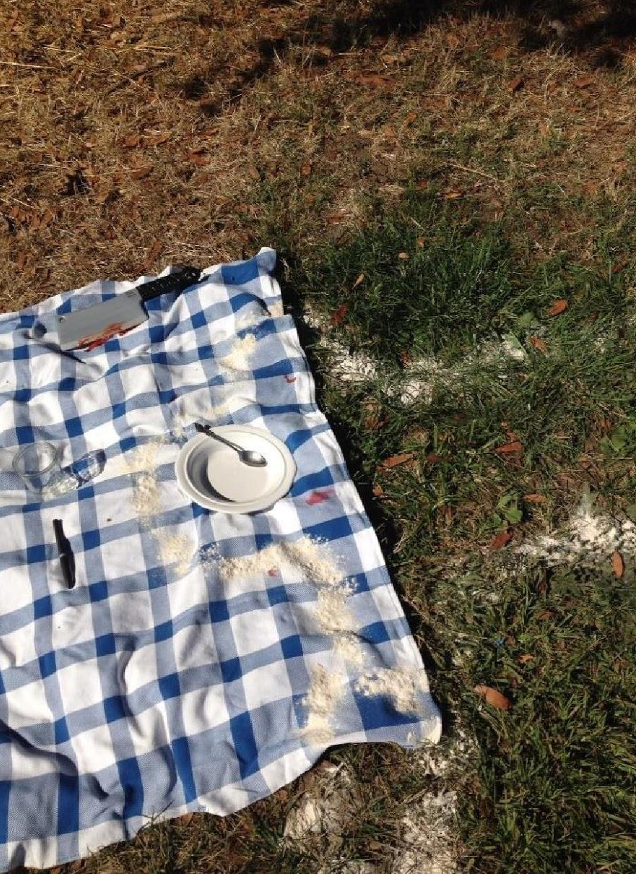
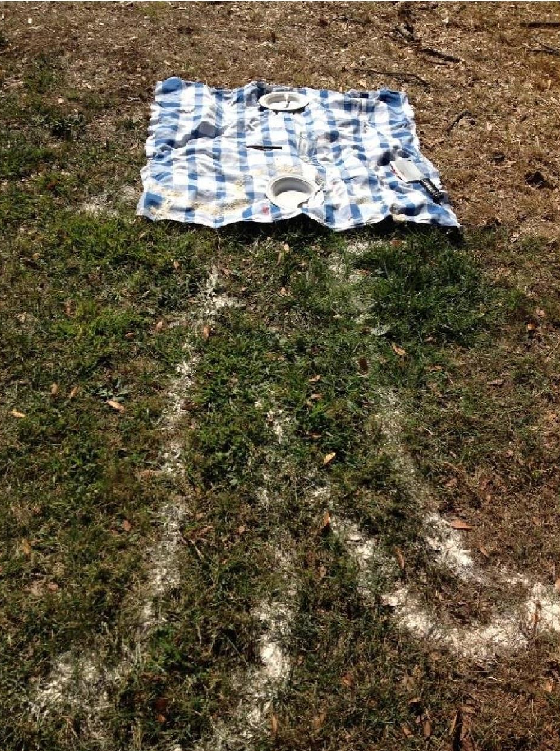
Crime Scene Picture 1
Crime Scene
Picture 2

Slide 4
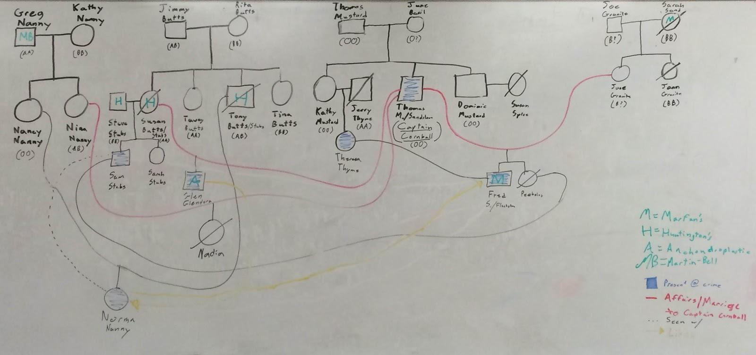
Family Pedigree

Slide 5
Thomas Sandstone
Captain Cornball (Victim)
Has affected all guests
Claims to have many children from different women
Name Change
O-Blood Type
Thomas Sandstone
Is connected with all guests
(Children, Daughter-in-law, Step-Children, etc.)
Many affairs with different women
Name Change
O-Blood Type
Missing

Slide 6
The Culprit
Norma Nanny - 1st Degree Murder
Has intent
Premeditated
Sam Stubs - Accomplice
Voluntarily helped
Has intent
Premeditated
Present at crime (not accessory)

Slide 7
Motives
Sam Stubs
Captain Cornball killed Sam Stub’s wife
Mother had an affair Captain Cornball
Norma Nanny
Seen plotting with Sam Stubs
Aunt had an affair with Captain Cornball

Slide 8
Evidence
Murder Weapon
Death Threat
Fingerprint on Glass

Slide 9
The Knife

Slide 10
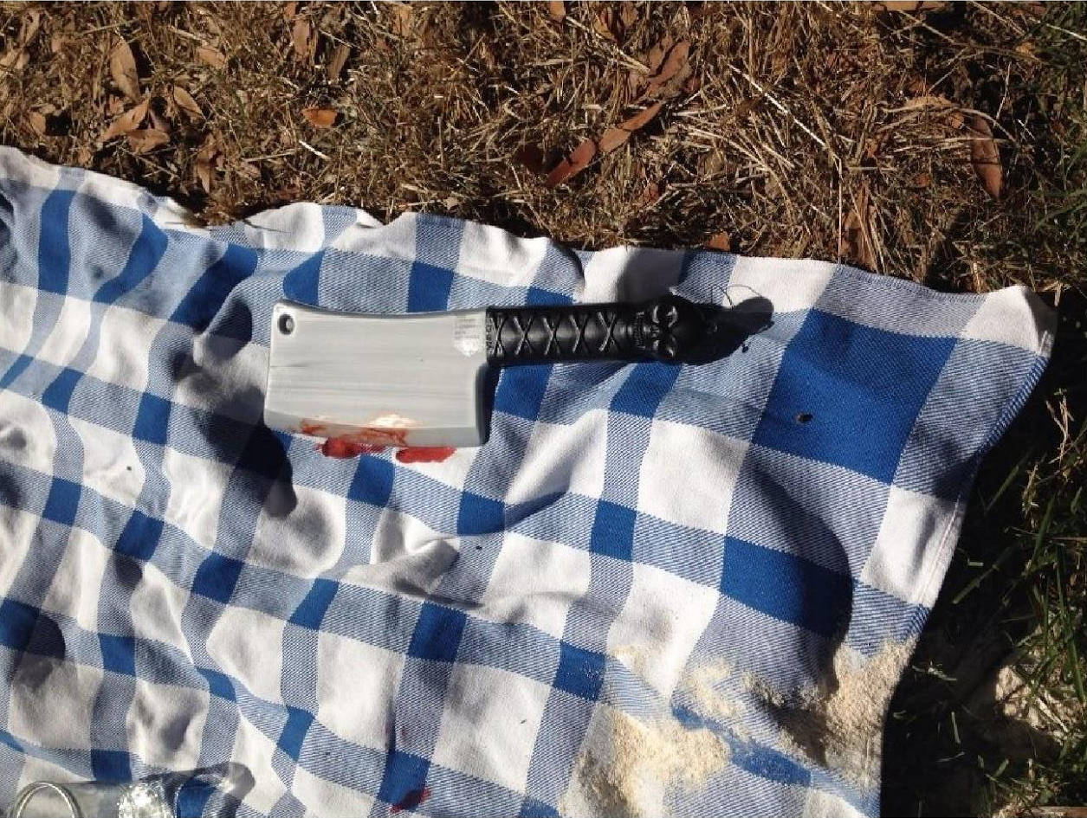
Knife used to kill Captain Cornball

Slide 11
The Knife
2 Different Blood Samples
Made Karyotypes of each suspect and Captain Cornball in addition to both crime samples
Karyotype - “Picture” of a person’s chromosomes

Slide 12
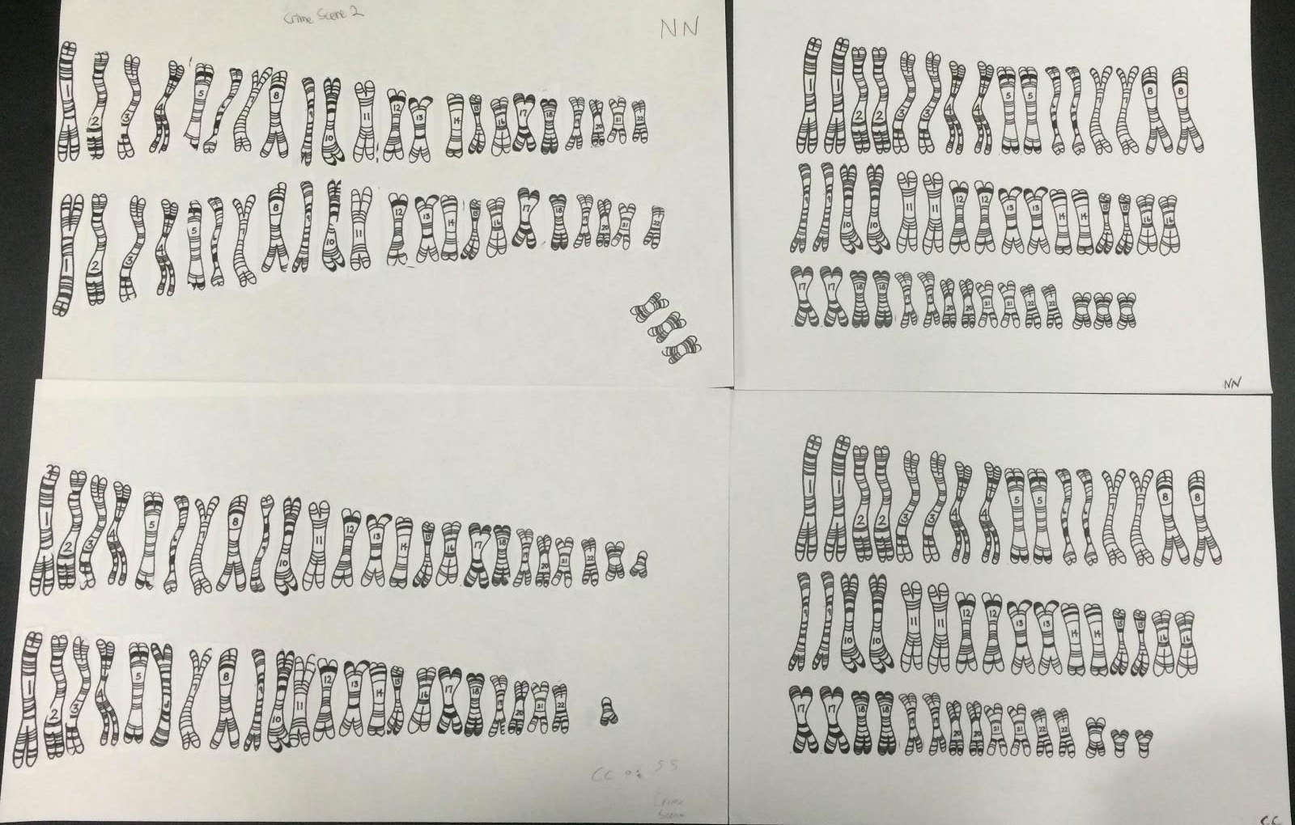
Karyotypes
Top Left -
Norma Nanny
Top Right -
Crime Scene
Bottom Left -
Captain Cornball/Sam Stubs
Bottom Right -
Crime Scene

Slide 13
Blood Types
Antiserum (Anti-A or Anti-B)
Clumping occurs when adding to blood of specific types
Determined blood types by adding both antiserums to samples and recording clumping

Slide 14
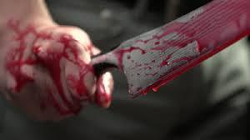
The Knife
Norma Nanny’s blood (1st blood sample) found in crime scene
She says that she cut her hand on a broken glass
Bled on knife when she stabbed Cornball (2nd blood sample)

Slide 15
The Death Threat

Slide 16
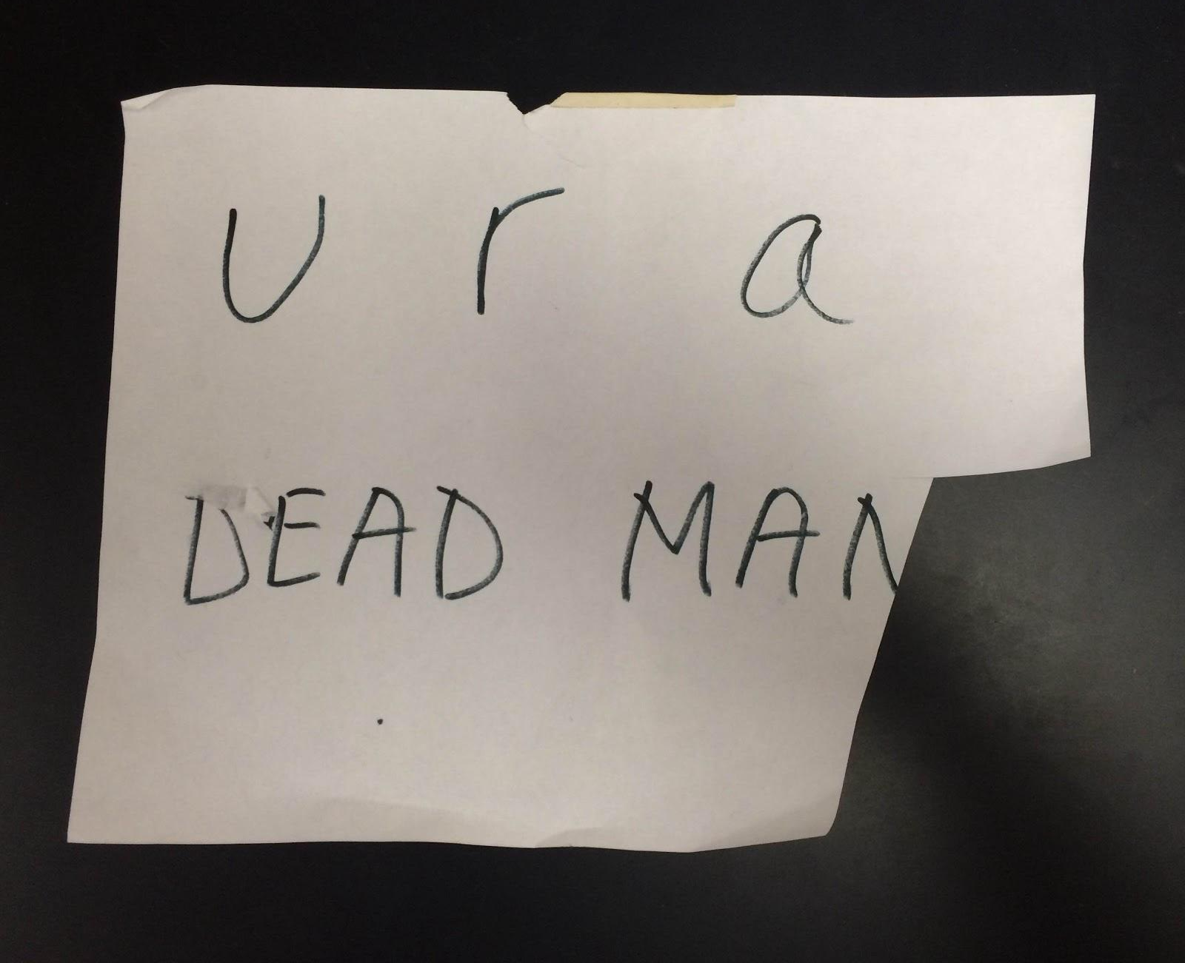
Death Threat to Captain Cornball

Slide 17
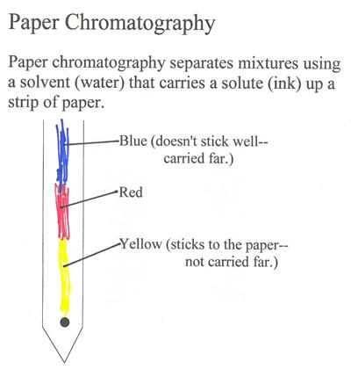
Chromatography
Used to analyze mixtures/solutions
We used it to analyze which pen was used to write the death threat

Slide 18
Death Threat
3 pens found at crime scene:
Ballpoint
Crayola
Sharpie

Slide 19
Chromatography
From Left to Right: Ballpoint Pen, Crayola Marker, Sharpie Permanent Marker

Slide 20
Death Threat
By comparing our chromatography strips to crime scene sample, we found that the Crayola Marker wrote the threat
Pen is known to belong to Norma Nanny (Killer) and Sam Stubs (accomplice)

Slide 21
The Knife Fingerprint

Slide 22
The Knife Fingerprint
Dusted fluorescent powder to highlight print
Lifted fingerprint
When under UV light, fingerprint is easily seen (Use UV shield of course!)

Slide 23
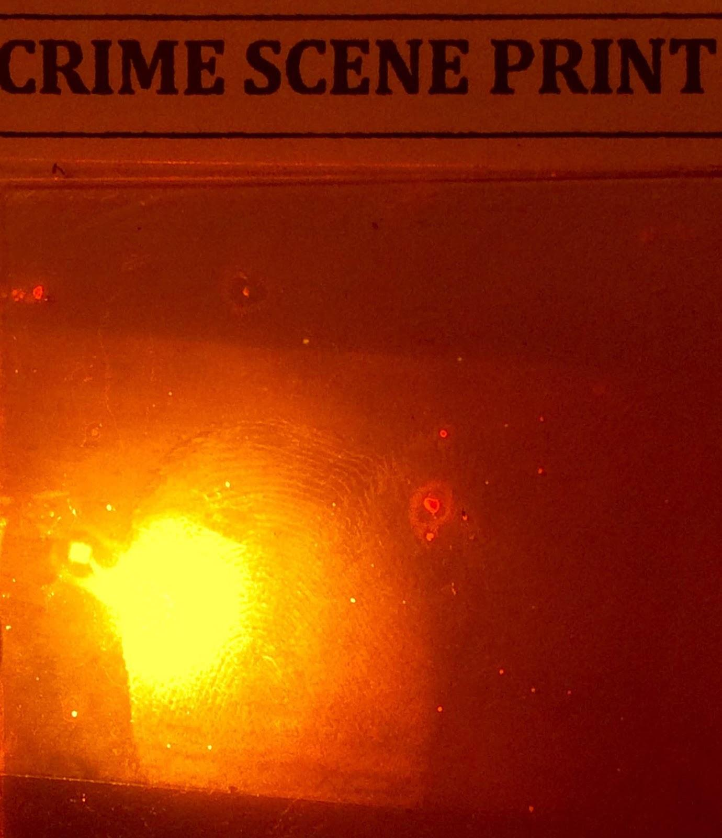
Crime Scene Print - Arch
Fred Fleckstone - Loop
Norma Nanny - Arch
Glen Glendora - Whorl
Theresa Thyme - Loop
Sam Stubs - Loop

Slide 24
Outline
Before:
Norma Nanny (killer) and Sam Stubs (accomplice) wrote a death threat to Captain Cornball (Killed Sam’s “old” wife and had an affair with Norma’s Aunt)
At The Scene:
Norma Nanny cut herself
Norma Nanny, stabbed Captain Cornball (Thomas Sandstone) using the murder knife
Fingerprints left on knife
Blood from wound is on knife

Slide 25
Conclusion
Norma Nanny (Killer)
Should be sentenced to 25 years in prison to life
Sam Stubs (Accomplice)
Same Sentence

Slide 26
Thank you!
Any Questions?

